Slide 1

Distributions
ML LABS PVT LTD || WWW.ANALYTICS6.COM || DATA SCIENCE , AI , ML ,COMPUTER VISION || TRAINING AND CONSULTING
Phone Number : 91-6362546088 || Email : contact@analytics6.com

Slide 2
Confidence interval
In statistics, confidence intervals are used to represent a range of values that is likely to contain a population parameter with a certain level of confidence.
ML LABS PVT LTD || WWW.ANALYTICS6.COM || DATA SCIENCE , AI , ML ,COMPUTER VISION || TRAINING AND CONSULTING
Phone Number : 91-6362546088 || Email : contact@analytics6.com

Slide 3
Confidence interval
The following general formula is used to calculate confidence intervals:
Confidence Interval = (point estimate) +/- (critical value)*(standard error)
This formula creates an interval with a lower bound and an upper bound, which likely contains a population parameter with a certain level of confidence.
ML LABS PVT LTD || WWW.ANALYTICS6.COM || DATA SCIENCE , AI , ML ,COMPUTER VISION || TRAINING AND CONSULTING
Phone Number : 91-6362546088 || Email : contact@analytics6.com

Slide 4
Confidence interval
This formula creates an interval with a lower bound and an upper bound, which likely contains a population parameter with a certain level of confidence.
Confidence Interval = [lower bound, upper bound]
ML LABS PVT LTD || WWW.ANALYTICS6.COM || DATA SCIENCE , AI , ML ,COMPUTER VISION || TRAINING AND CONSULTING
Phone Number : 91-6362546088 || Email : contact@analytics6.com

Slide 5
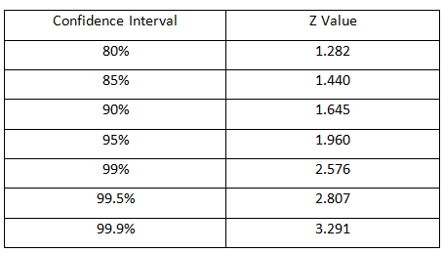
Commonly used z -values for Confidence interval
ML LABS PVT LTD || WWW.ANALYTICS6.COM || DATA SCIENCE , AI , ML ,COMPUTER VISION || TRAINING AND CONSULTING
Phone Number : 91-6362546088 || Email : contact@analytics6.com

Slide 6
Confidence interval
Confidence intervals are often used in clinical trials to determine the mean change in blood pressure, heart rate, cholesterol, etc. produced by some new drug or treatment.
ML LABS PVT LTD || WWW.ANALYTICS6.COM || DATA SCIENCE , AI , ML ,COMPUTER VISION || TRAINING AND CONSULTING
Phone Number : 91-6362546088 || Email : contact@analytics6.com

Slide 7
Confidence interval
For example,
A doctor may believe that a new drug is able to reduce blood pressure in patients. To test this, he may recruit 20 patients to participate in a trial in which they used the new drug for one month.
At the end of the month, the doctor may record the mean decrease in blood pressure and the standard deviation of the decrease in each patient in the sample.
ML LABS PVT LTD || WWW.ANALYTICS6.COM || DATA SCIENCE , AI , ML ,COMPUTER VISION || TRAINING AND CONSULTING
Phone Number : 91-6362546088 || Email : contact@analytics6.com

Slide 8
Confidence interval
For example,
He could then use the sample mean and sample standard deviation to construct an interval for the true mean change in blood pressure that patients are likely to experience in the population.
ML LABS PVT LTD || WWW.ANALYTICS6.COM || DATA SCIENCE , AI , ML ,COMPUTER VISION || TRAINING AND CONSULTING
Phone Number : 91-6362546088 || Email : contact@analytics6.com

Slide 9
Test of hypothesis for small samples:
There are 3 types tests in tests of hypothesis for small samples.
T- distribution
F-distribution
χ²-distribution
ML LABS PVT LTD || WWW.ANALYTICS6.COM || DATA SCIENCE , AI , ML ,COMPUTER VISION || TRAINING AND CONSULTING
Phone Number : 91-6362546088 || Email : contact@analytics6.com

Slide 10
Test of hypothesis for small samples:
In T-distribution there are two types of t- tests
- t- distribution for single mean
- t- distribution for difference of means
ML LABS PVT LTD || WWW.ANALYTICS6.COM || DATA SCIENCE , AI , ML ,COMPUTER VISION || TRAINING AND CONSULTING
Phone Number : 91-6362546088 || Email : contact@analytics6.com

Slide 11
T - distribution
The t-distribution, also known as Student’s t-distribution, is a way of describing data that follow a bell curve when plotted on a graph, with the greatest number of observations close to the mean and fewer observations in the tails.
ML LABS PVT LTD || WWW.ANALYTICS6.COM || DATA SCIENCE , AI , ML ,COMPUTER VISION || TRAINING AND CONSULTING
Phone Number : 91-6362546088 || Email : contact@analytics6.com

Slide 12
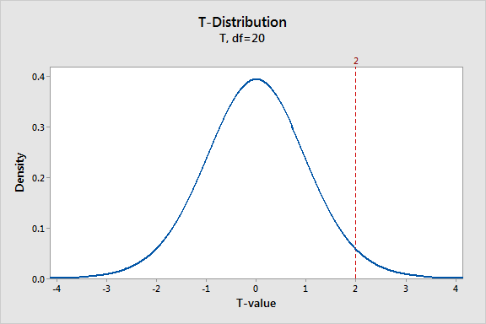
T - distribution
It is a type of normal distribution used for smaller sample sizes, where the variance in the data is unknown.
ML LABS PVT LTD || WWW.ANALYTICS6.COM || DATA SCIENCE , AI , ML ,COMPUTER VISION || TRAINING AND CONSULTING
Phone Number : 91-6362546088 || Email : contact@analytics6.com

Slide 13
What is a T – distribution ?
The t-distribution is a type of normal distribution that is used for smaller sample sizes.
Normally-distributed data form a bell shape when plotted on a graph, with more observations near the mean and fewer observations in the tails.
ML LABS PVT LTD || WWW.ANALYTICS6.COM || DATA SCIENCE , AI , ML ,COMPUTER VISION || TRAINING AND CONSULTING
Phone Number : 91-6362546088 || Email : contact@analytics6.com

Slide 14
What is a T – distribution ?
The t-distribution is used when data are approximately normally distributed, which means the data follow a bell shape but the population variance is unknown.
The variance in a t-distribution is estimated based on the degrees of freedom of the data set (total number of observations minus 1).
ML LABS PVT LTD || WWW.ANALYTICS6.COM || DATA SCIENCE , AI , ML ,COMPUTER VISION || TRAINING AND CONSULTING
Phone Number : 91-6362546088 || Email : contact@analytics6.com

Slide 15
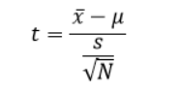
The T – distribution
When a sample size is less than 30, and the random variable X is approximately normally distributed, it follow a t-distribution.
ML LABS PVT LTD || WWW.ANALYTICS6.COM || DATA SCIENCE , AI , ML ,COMPUTER VISION || TRAINING AND CONSULTING
Phone Number : 91-6362546088 || Email : contact@analytics6.com

Slide 16
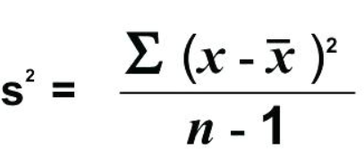
T – distribution for single mean
A sample of size n with mean x̄ and variance s² is taken from the population having mean μ and σ² variance, then the test statistic is given by
ML LABS PVT LTD || WWW.ANALYTICS6.COM || DATA SCIENCE , AI , ML ,COMPUTER VISION || TRAINING AND CONSULTING
Phone Number : 91-6362546088 || Email : contact@analytics6.com

Slide 17
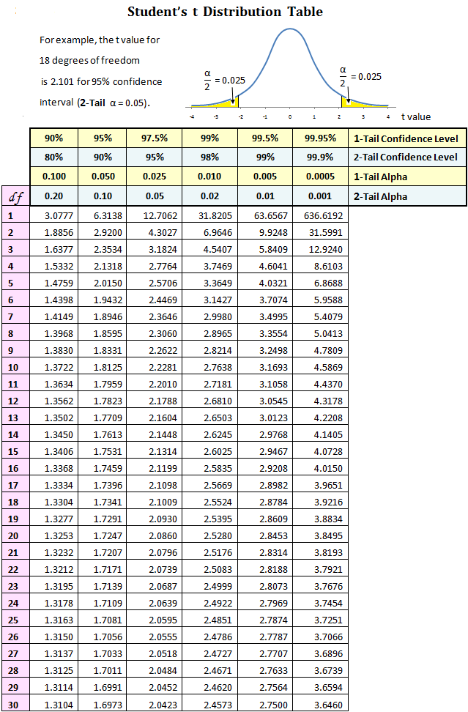
T – distribution
ML LABS PVT LTD || WWW.ANALYTICS6.COM || DATA SCIENCE , AI , ML ,COMPUTER VISION || TRAINING AND CONSULTING
Phone Number : 91-6362546088 || Email : contact@analytics6.com

Slide 18
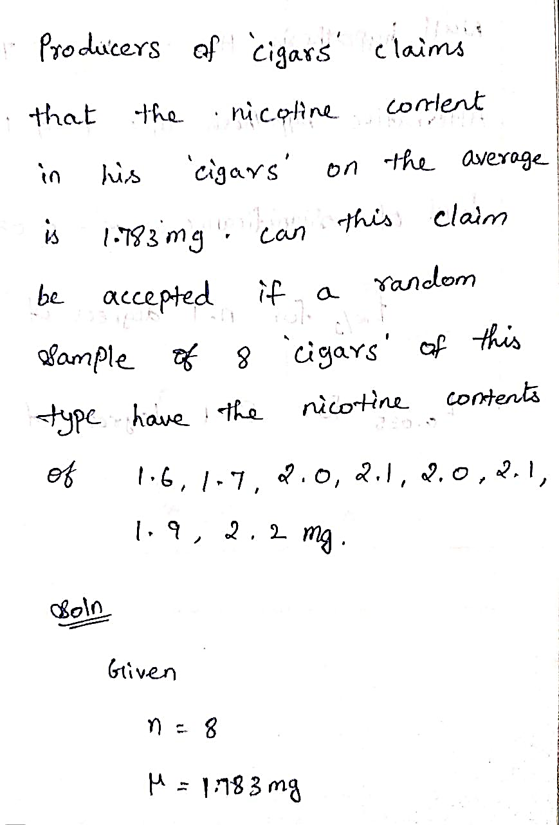
T – distribution problem
ML LABS PVT LTD || WWW.ANALYTICS6.COM || DATA SCIENCE , AI , ML ,COMPUTER VISION || TRAINING AND CONSULTING
Phone Number : 91-6362546088 || Email : contact@analytics6.com

Slide 19
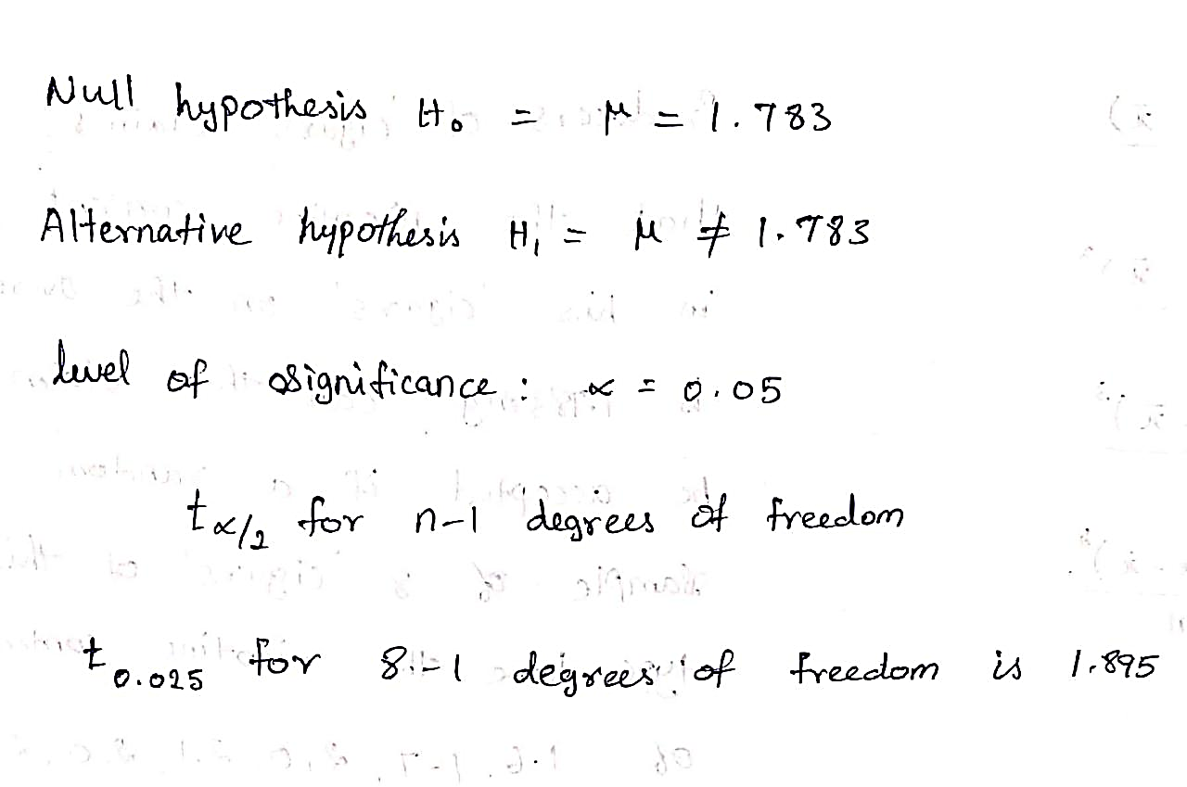
T – distribution problem
ML LABS PVT LTD || WWW.ANALYTICS6.COM || DATA SCIENCE , AI , ML ,COMPUTER VISION || TRAINING AND CONSULTING
Phone Number : 91-6362546088 || Email : contact@analytics6.com

Slide 20
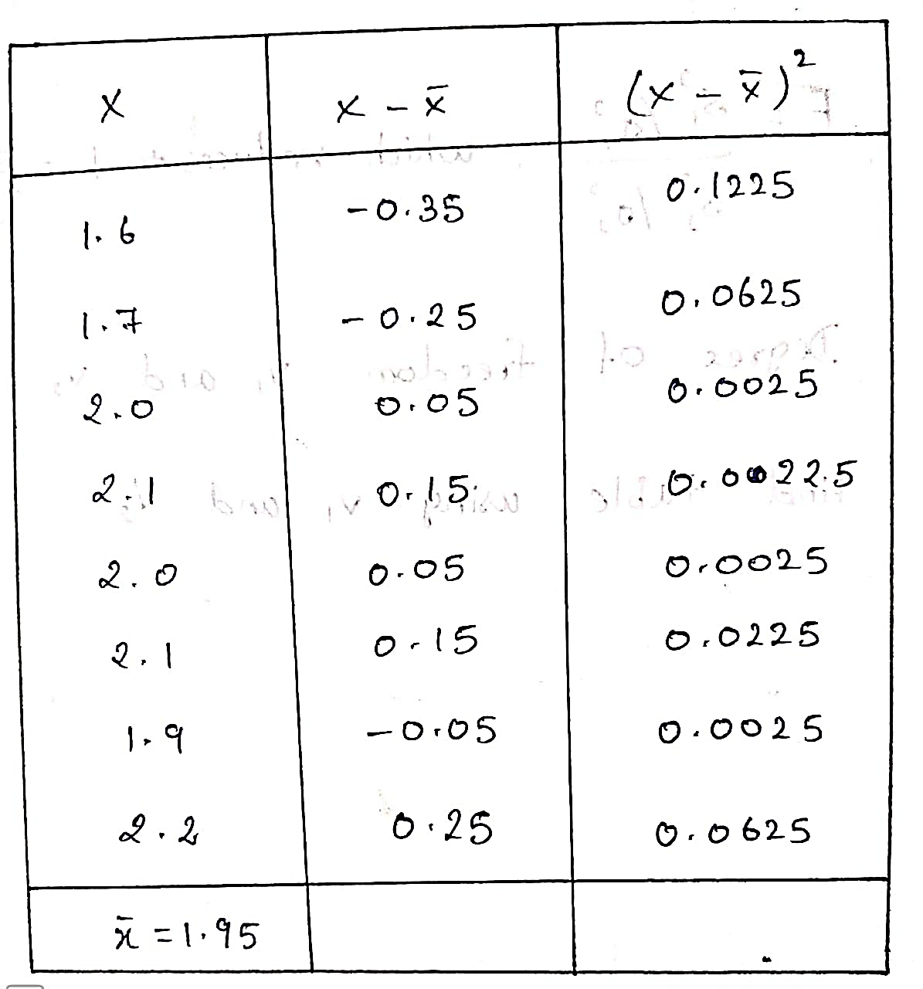
T – distribution problem
ML LABS PVT LTD || WWW.ANALYTICS6.COM || DATA SCIENCE , AI , ML ,COMPUTER VISION || TRAINING AND CONSULTING
Phone Number : 91-6362546088 || Email : contact@analytics6.com

Slide 21
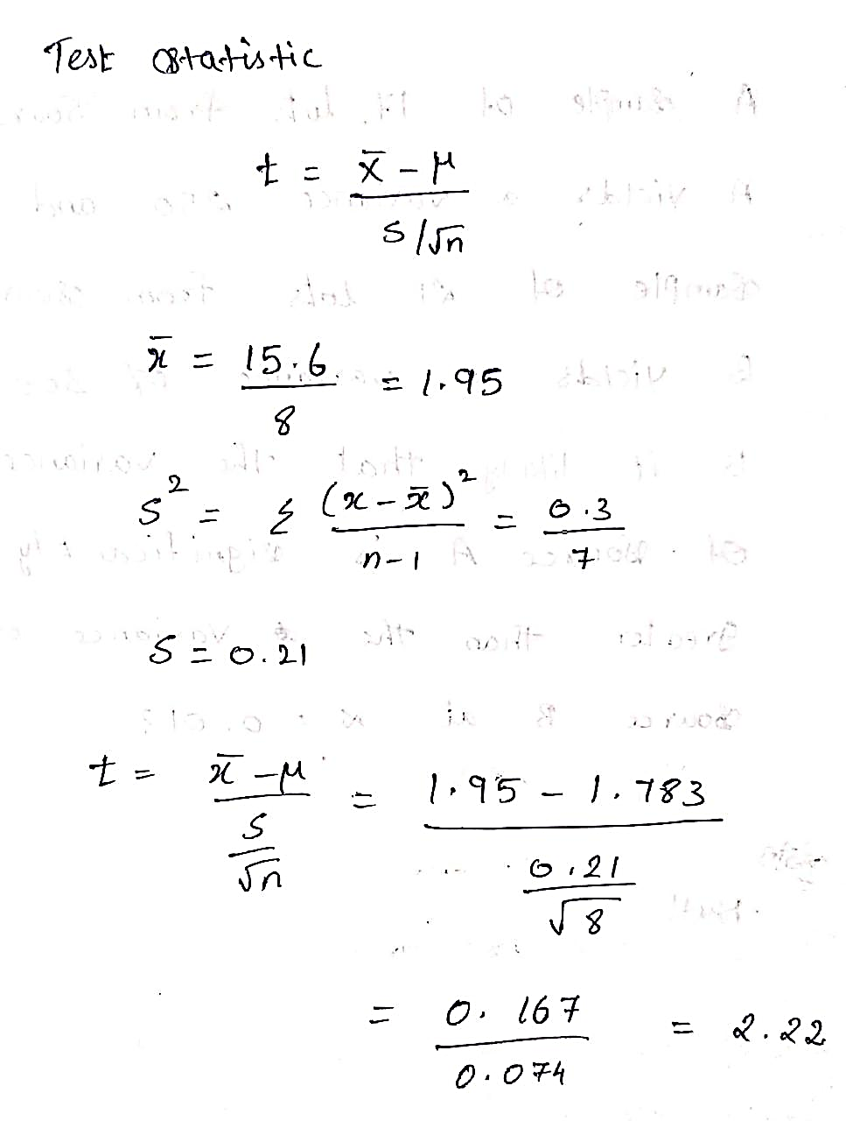
T – distribution problem
ML LABS PVT LTD || WWW.ANALYTICS6.COM || DATA SCIENCE , AI , ML ,COMPUTER VISION || TRAINING AND CONSULTING
Phone Number : 91-6362546088 || Email : contact@analytics6.com

Slide 22
F – distribution
F distribution used for comparing the variance of two populations.
It is defined in terms of ratio of the variances of two normally distributed populations.
It sometimes also called variance ratio.
ML LABS PVT LTD || WWW.ANALYTICS6.COM || DATA SCIENCE , AI , ML ,COMPUTER VISION || TRAINING AND CONSULTING
Phone Number : 91-6362546088 || Email : contact@analytics6.com

Slide 23
F – distribution
F distribution used for comparing the variance of two populations.
It is defined in terms of ratio of the variances of two normally distributed populations.
It sometimes also called variance ratio.
ML LABS PVT LTD || WWW.ANALYTICS6.COM || DATA SCIENCE , AI , ML ,COMPUTER VISION || TRAINING AND CONSULTING
Phone Number : 91-6362546088 || Email : contact@analytics6.com

Slide 24
F – distribution
The F-distribution is generally a skewed distribution and also related to a chi-squared distribution.
The distribution used for the hypothesis test is a new one. It is called the F distribution
ML LABS PVT LTD || WWW.ANALYTICS6.COM || DATA SCIENCE , AI , ML ,COMPUTER VISION || TRAINING AND CONSULTING
Phone Number : 91-6362546088 || Email : contact@analytics6.com

Slide 25

F – distribution
The f distribution is the ratio of X1 random chi-square variable with degrees of freedom ϑ1 and X2 random chi-square variable with degrees of freedom ϑ2. (In other words each of the chi-square random variable has been divided by its degrees of freedom)
ML LABS PVT LTD || WWW.ANALYTICS6.COM || DATA SCIENCE , AI , ML ,COMPUTER VISION || TRAINING AND CONSULTING
Phone Number : 91-6362546088 || Email : contact@analytics6.com

Slide 26
Properties of an F – distribution
It is positively skewed and its skewness decreases with increase in ϑ1 and ϑ2.
The value of F always positive or zero. No negative values.so its value lies between 0 and ∞.
The shape of the distribution depends on the degrees of freedom of numerator ϑ1 and denominator ϑ2.
ML LABS PVT LTD || WWW.ANALYTICS6.COM || DATA SCIENCE , AI , ML ,COMPUTER VISION || TRAINING AND CONSULTING
Phone Number : 91-6362546088 || Email : contact@analytics6.com

Slide 27
Assumptions of an F – distribution
Assumes both populations are normally distributed.
Both the populations are independent to each other.
The larger sample variance always goes in the numerator to make the right tailed test, and the right tailed tests are always easy to calculate.
ML LABS PVT LTD || WWW.ANALYTICS6.COM || DATA SCIENCE , AI , ML ,COMPUTER VISION || TRAINING AND CONSULTING
Phone Number : 91-6362546088 || Email : contact@analytics6.com

Slide 28
Testing of hypothesis for equality of two variances
It is based on the variances in two independently selected random samples drawn from two normal populations.
If calculated F value exceeds table F value, null hypothesis is rejected.
ML LABS PVT LTD || WWW.ANALYTICS6.COM || DATA SCIENCE , AI , ML ,COMPUTER VISION || TRAINING AND CONSULTING
Phone Number : 91-6362546088 || Email : contact@analytics6.com

Slide 29
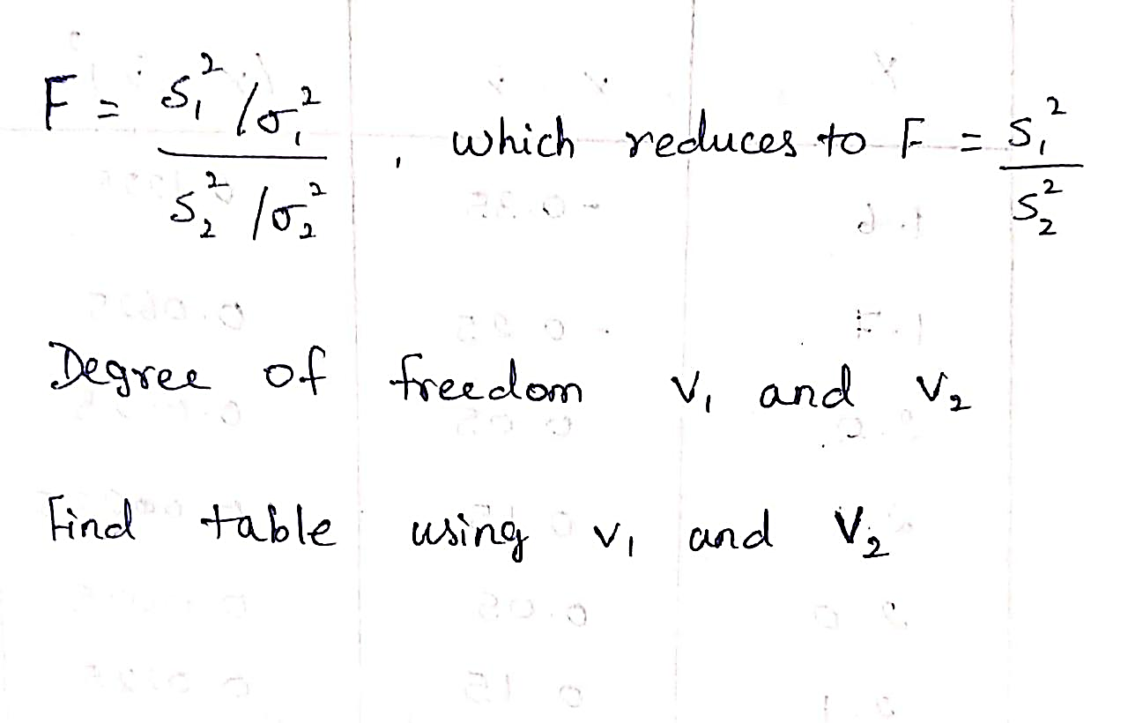
Testing of hypothesis for equality of two variances
ML LABS PVT LTD || WWW.ANALYTICS6.COM || DATA SCIENCE , AI , ML ,COMPUTER VISION || TRAINING AND CONSULTING
Phone Number : 91-6362546088 || Email : contact@analytics6.com

Slide 30
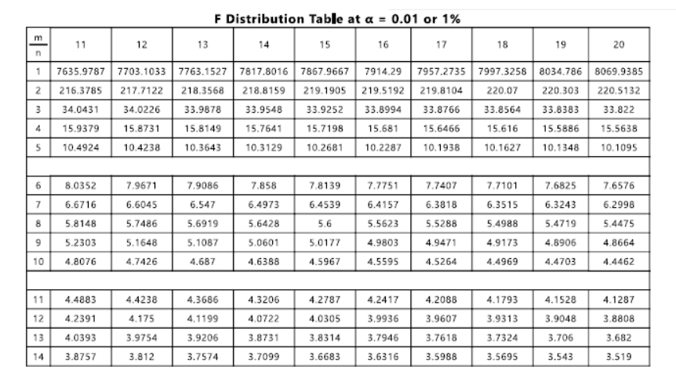
F- distribution table
ML LABS PVT LTD || WWW.ANALYTICS6.COM || DATA SCIENCE , AI , ML ,COMPUTER VISION || TRAINING AND CONSULTING
Phone Number : 91-6362546088 || Email : contact@analytics6.com

Slide 31
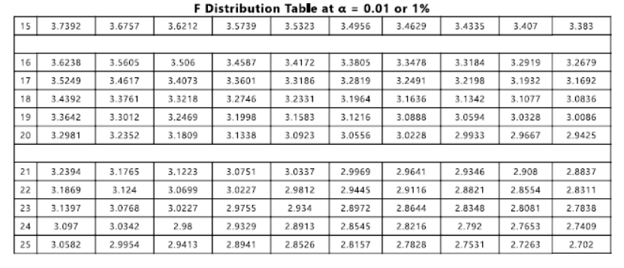
F- distribution table
ML LABS PVT LTD || WWW.ANALYTICS6.COM || DATA SCIENCE , AI , ML ,COMPUTER VISION || TRAINING AND CONSULTING
Phone Number : 91-6362546088 || Email : contact@analytics6.com

Slide 32
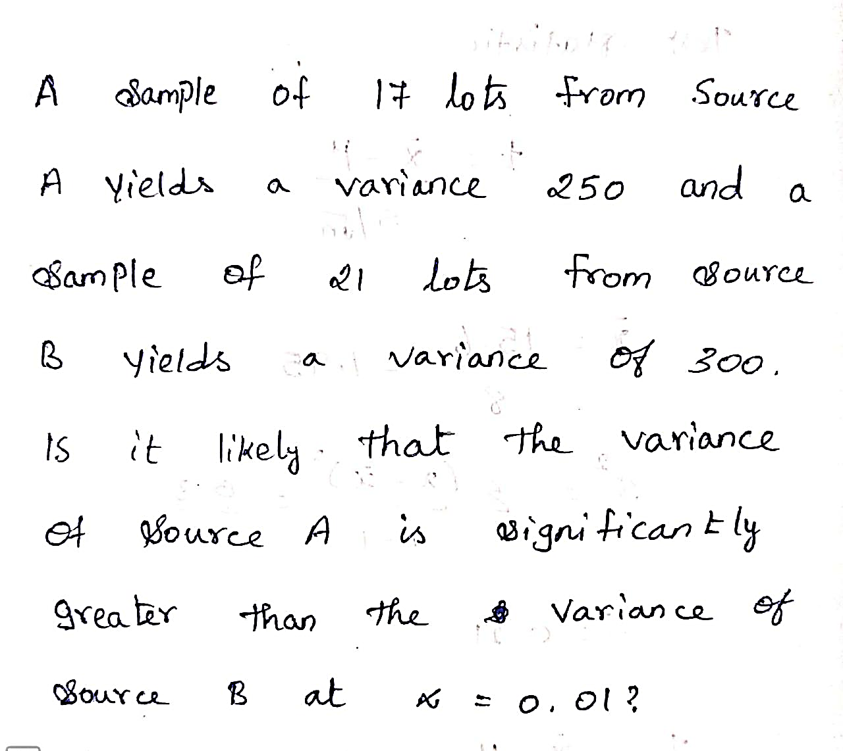
F- distribution problem
ML LABS PVT LTD || WWW.ANALYTICS6.COM || DATA SCIENCE , AI , ML ,COMPUTER VISION || TRAINING AND CONSULTING
Phone Number : 91-6362546088 || Email : contact@analytics6.com

Slide 33
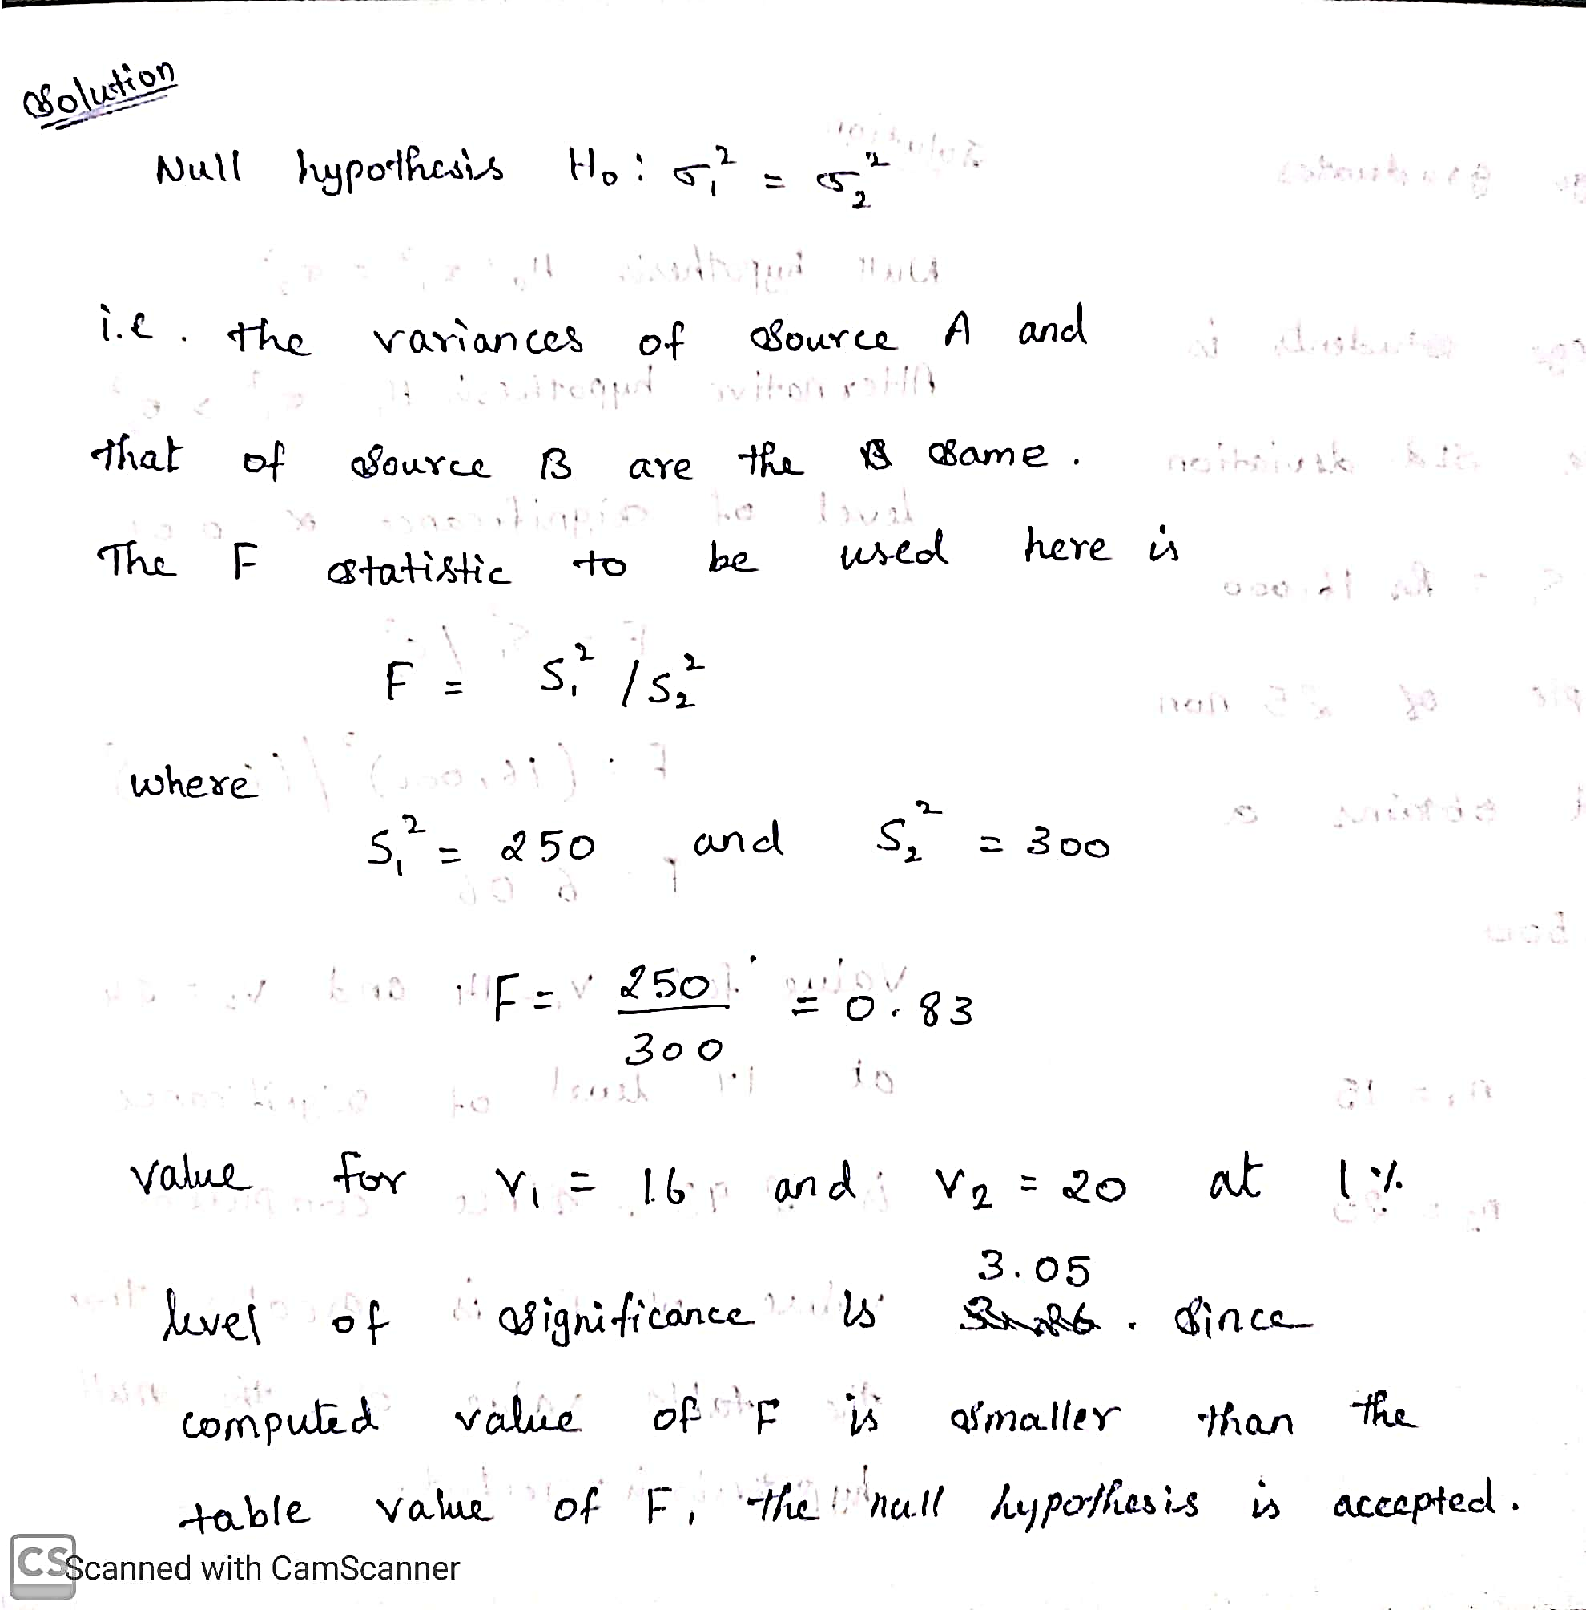
F- distribution problem
ML LABS PVT LTD || WWW.ANALYTICS6.COM || DATA SCIENCE , AI , ML ,COMPUTER VISION || TRAINING AND CONSULTING
Phone Number : 91-6362546088 || Email : contact@analytics6.com

Slide 34
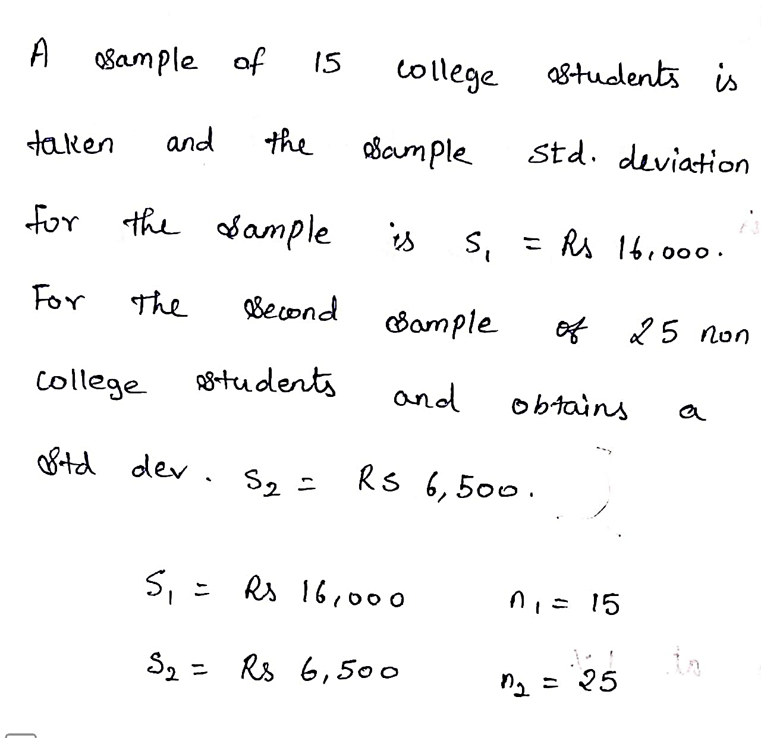
F- distribution problem
ML LABS PVT LTD || WWW.ANALYTICS6.COM || DATA SCIENCE , AI , ML ,COMPUTER VISION || TRAINING AND CONSULTING
Phone Number : 91-6362546088 || Email : contact@analytics6.com

Slide 35
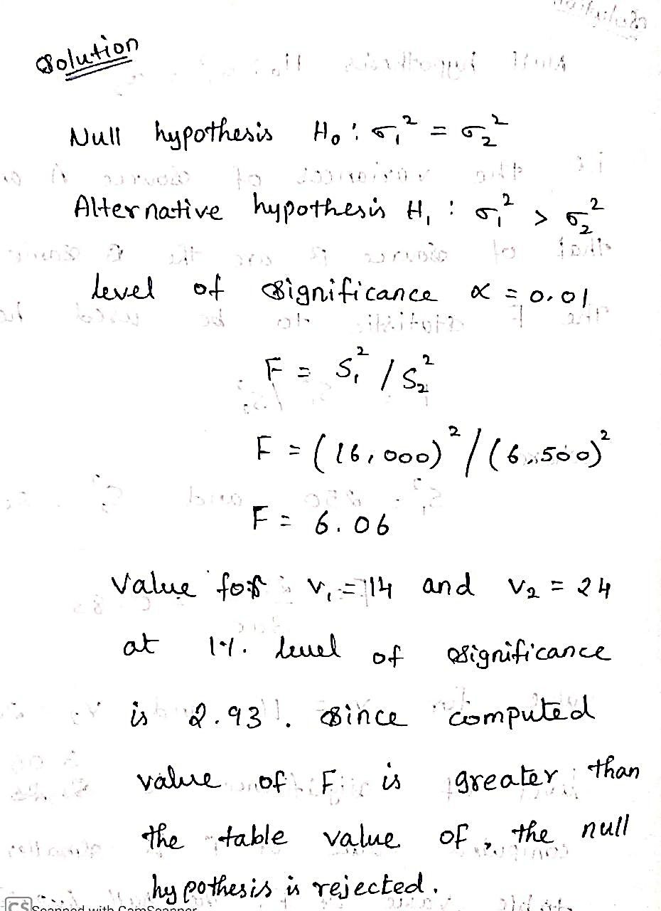
F- distribution problem
ML LABS PVT LTD || WWW.ANALYTICS6.COM || DATA SCIENCE , AI , ML ,COMPUTER VISION || TRAINING AND CONSULTING
Phone Number : 91-6362546088 || Email : contact@analytics6.com

